Slide 1
1 Introduction to Object-Oriented
OO Programming (procedural V.S. OO)
Basic concepts of OO

Slide 2
OO Programming

Slide 3




Designing Programs
Software Development – Solving Problem
Place Order
Problem Space
Inventory
Shipping
Descriptions of problem (Human: Requirements)
Business Process
Natural Language
A Gap between languages
Descriptions of solution (Human: Designing Program )
Programming Language
Solution Space
Execution of program
Computer System

Slide 4
Software Development – Solving Problem
Place Order
Problem Space
Inventory
Shipping
Descriptions of problem (Human: Requirements)
Business Process
Natural Language
A Gap between languages
Programming Language
Descriptions of solution (Human: Designing Programs)
High-Level Language (Object-Oriented) e.g. C++ Java
High-Level Language (Procedural) e.g. C, BASIC
Assembly Language
Machine Language
Solution Space
Execution of program
Computer System

Slide 5
Procedural Programming
This programming paradigm is essentially an abstraction of machine /assembly language.
Program is organized around procedures.
Focus on data structures, algorithms and sequencing of steps
Programs = Algorithm + Data Structure
An algorithm is a set of instructions for solving a problem
A data structure is a construct used to organize data in a specific way.
Most computer languages, from early examples like FORTRAN and ALGOL to more recent languages like C and Ada, have been imperative or procedural.

Slide 6
Procedural Programming - Example
Writing a program to handle bank accounts
  Customer can open different type of accounts, such as cash account, check account and Loan account.
  For each account, customer can deposit, withdraw or transfer.
How to write this program with C ?

Slide 7
Procedural Programming - Example
Programs = Algorithm + Data Structure
Struct account {
char name;
int accountId;
float balance;
float interestYTD;
char accountType;
};
Procedure 1: Deposit() {...}
Data Structure:
Bank Account
Procedure 1: Withdraw() {...}
Procedure 1: Transfer() {...}
A procedural programming language usually consists of :
  A collection of variables, each of which at any stage contains a certain value (a number, a character, a string of characters, etc)
  A collection of statements that change the values of these variables.
The building-block of this type program is the procedure or function.

Slide 8
Procedural Programming - Disadvantages
Procedures and data are clearly separated.
Transformation of concepts between analysis & implementation.
Design models are a long step from implementation.
Procedures are often hard to reuse.
Programs are often hard to extend and maintain.
Data
a gap
Procedure
Analysis
a gap
Design
NJ
NY
NJ
NY
Hudson river
Hudson river

Slide 9
Object-Oriented Programming: OOP
A design and programming technique
Some terminology:
  object - usually a person, place or thing (a noun)
  method - an action performed by an object (a verb)
  type or class - a category of similar objects (such as automobiles)
Objects have both data and methods
Objects of the same class have the same data elements and methods
Objects send and receive messages to invoke actions

Slide 10
Object-Oriented Programming - Example
Writing a program to handle bank accounts
  Customer can open different type of accounts, such as cash account, check account and Loan account.
  For each account, customer can deposit, withdraw or transfer.
How to write this program with C++ or Java ?

Slide 11
Object-Oriented Programming - Example
Object-Oriented approach
  combine the accounts (data) with the operations on the accounts to objects.
  A new kind of data type: BankAccount class
C++ code:
Class BankAccount {
private:
float balance;
float interestYTD;char * owner;
int account_number;
public:
void Deposit (float amount) {...}
float WithDraw (float amount) {…}
bool Transfer (BankAccount & to, float amount) {…}
};

Slide 12
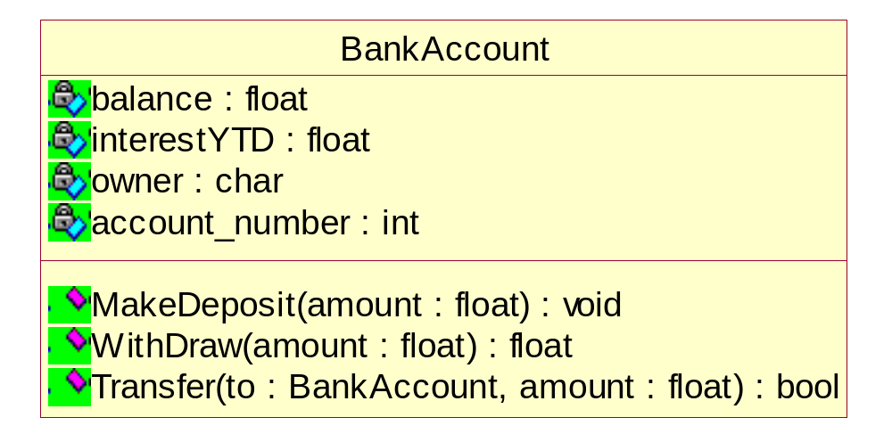
Object-Oriented Programming - Example
The building-block of this type program is class or objects.

Slide 13
Example - The Shape Application
We have an application that must be able to draw circles and squares on a standard GUI
The circles and squares must be drawn in a particular order.
A list of the circles and squares will be created in the appropriate order, and the program must walk the list in that order and draw each circle or square.

Slide 14
Example - Procedural Programming in C
Data Structure
---Shape.h --------------------------------------------
Enum Shape {circle, square};
struct Shape {
ShapeType itsType;
};
---Circle.h --------------------------------------------
struct Circle {
Shape itsType;
double itsRadius;
Point itsCenter;
};
---square.h -------------------------------------------
struct Square {
Shape itsType;
double itsSide;
Point itsTopLeft;
};

Slide 15
Example - Procedural Programming in C
Function
---drawAllShapes.c --------------------------------------------
typedef struct Shape *ShapePointer;
Void DrawAllShapes (ShapePointer list[], int n) {
int I;
for (i=0; i<n; i++) {
struct Shape* s = list[i];
switch (s->itsType) {
case square:
DrawSquare((struct Square*)s);
break;
case circle:
DrawCircle((struct Circle*)s);
break;
}
}
}

Slide 16
Example - Procedural Programming in C
Problems
  Rigid: because the addition of Triangle causes Shape,Square,Circle, and DrawAllShapes to be recompiled and redeployed.
  Fragile: because there will be many other switch/case or if/else statements that are both hard to find and hard to decipher.
  Immobile: because anyone attempting to reuse DrawAllShapes in another program is required to bring along Square and Circle, even if that new program does not need them.

Slide 17
Example – Object-Oriented Programming in C++
class Shape {
public:
virtural void Draw() const= 0;
};
class Square : public Shape {
public:
virtual void Draw() const;
};
class Circle : public Shape {
public:
virtual void Draw() const;
};
void DrawAllShapes(vector <Shape*>& list) {
vector<Shape*> :: iterator I;
for (i = list.begin(); i != list.end(); i++)
(*i)->Draw();
}
It is changed by adding new code rather than by changing existing code.
Not rigid
Not Fragile
Not Immobile

Slide 18
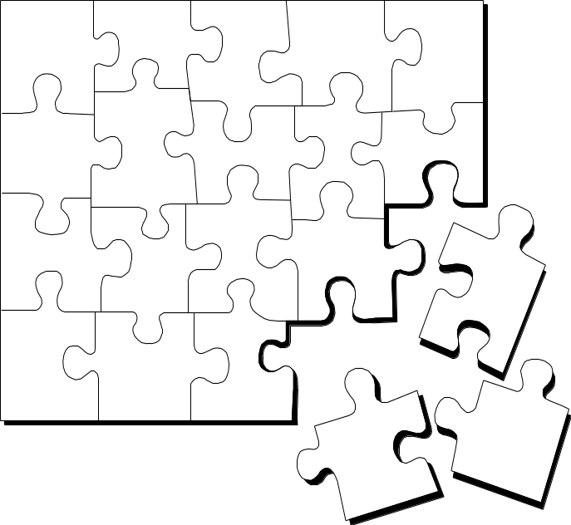
What Is Object Technology?
Object Technology
  A set of principles guiding software construction together with languages, databases, and other tools that support those principles.
  (Object Technology - A Manager’s Guide, Taylor, 1997)
Notes:
Object technology is not simply the use of an object-oriented language like Java or C++. It is based on the principles of abstraction, modularity, hierarchy, and encapsulation. (These will be defined in Module 3.)
If an organization is to successfully implement object technology, they must use more than a language. They must also use process, a modeling language (UML), data modeling techniques, and so on.

Slide 19
The History of Object Technology
Major object technology milestones
Simula
C ++
The UML
1967
Late 1980s
1996
1972
1991
2000+
Smalltalk
Java
???
Notes:
Object technology is not a new idea. It has been around for over 30
years. Below is a brief history of the major milestones in the history of object technology.
In 1967, Simula was designed and became the first language to use objects and classes.
In 1972, Alan Kay and others at Xerox PARC created Smalltalk whose roots were tied to Simula. In 1980 Smalltalk became the first commercial release of an object-oriented programming environment.
Bjarne Stroustrop, the originator of the C++ language, released C++ to the public in the late 1980’s. C++ was not an entirely new language, but an extension of C abilities.
In 1991, James Gosling, created a language named Oak that was the predecessor to Java. It was created because his development team at Sun Microsystems was writing software for information appliances. He found that C++ was too complex and insecure for the job. Therefore, he created the Oak language.
We’ve included this slide to show students that object technology is not new. It has been around for a long time and is a proven and fairly mature technology.

Slide 20
Strengths of Object Technology
A single paradigm
  A single language used by users, analysts, designers, and implementers
Facilitates architectural and code reuse
Models more closely reflect the real world
  More accurately describes corporate entities
  Decomposed based on natural partitioning
  Easier to understand and maintain
Stability
  A small change in requirements does not mean massive changes in the system under development
Adaptive to change
Notes:
An object-oriented model aims at reflecting the world we experience in reality. Thus, the objects themselves often correspond to phenomena in the real world that the system is to handle. For example, an object can be an invoice in a business system or an employee in a payroll system.
Object technology can help a company change its systems almost as fast as the company itself changes.

Slide 21
Basic concepts of OO

Slide 22
Basic Concepts of Object Orientation
Object
Class
Message
Basic Principles of Object Orientation
Abstraction
Encapsulation
Inheritance
Polymorphism
Interface and Abstract Class

Slide 23

What Is an Object?
Informally, an object represents an entity, either physical, conceptual, or software.
  Physical entity
  Conceptual entity
  Software entity
Truck
Chemical Process
Linked List
Notes:
Objects allow the software developer to represent real-world concepts in their software design. These real-world concepts can represent a physical entity such as a person, truck, or space shuttle.
Objects can be concepts like a chemical process or algorithms.
Object can even represent software entities like a linked list.

Slide 24

A More Formal Definition
An object is an entity with a well-defined boundary and identity that encapsulates state and behavior.
  State is represented by attributes and relationships.
  Behavior is represented by operations, methods, and state machines.
Attributes
Object
Operations
Notes:
An object is an entity that has a well-defined boundary. That is, the purpose of the object should be clear.
An object has two key components: attributes and operations.
Attributes represent an object’s state, and operations represent the behavior of the object.
Object behavior and state are discussed in the next few slides.
Take a moment to explain the graphic on this slide.
Attributes are documented on the inside of the doughnut.
Operations are documented on the borders, which will become clear to the student as we discuss topics like encapsulation.
Note that the doughnut is not part of the UML notation. UML notation will be discussed later.

Slide 25
An Object Has State
The state of an object is one of the possible conditions in which an object may exist.
The state of an object normally changes over time.
Name: J Clark
Employee ID: 567138
HireDate: 07/25/1991
Status: Tenured
Discipline: Finance
MaxLoad: 3
Professor Clark
Name: J Clark
Employee ID: 567138
Date Hired: July 25, 1991
Status: Tenured
Discipline: Finance
Maximum Course Load: 3 classes
Professor Clark
Notes:
The state of an object is one of the possible conditions that an object may exist in, and it normally changes over time.
The state of an object is usually implemented by a set of properties called attributes, along with the values of the properties and the links the object may have with other objects.
State is not defined by a “state” attribute or set of attributes. Instead, state is defined by the total of an object’s attributes and links. For example, if Professor Clark’s status changed from Tenured to Retired, the state of the Professor Clark object will change.
Provide some supplemental state exercises to ensure that the class understands the concept of state.

Slide 26
An Object Has Behavior
Behavior determines how an object acts and reacts.
The visible behavior of an object is modeled by the set of messages it can respond to (operations the object can perform).
SubmitFinalGrades()
AcceptCourseOffering()
Professor Clark
Professor Clark’s behavior
  Submit Final Grades
  Accept Course Offering
  Take Sabbatical
Maximum Course Load: 3 classes
SetMaxLoad()
TakeSabbatical()
Professor Clark
Notes:
The second characteristic of an object is that it has behavior. Objects are intended to mirror the concepts that they are modeled after, including behavior.
Behavior determines how an object acts and reacts to requests from other objects.
Object behavior is represented by the operations that the object can perform. For example, Professor Clark can choose to take a sabbatical once every five years. The Professor Clark object represents this behavior through the TakeSabbatical() operation.

Slide 27


An Object Has Identity
Each object has a unique identity, even if the state is identical to that of another object.
Professor “J Clark” teaches Biology
Professor “J Clark” teaches Biology
Notes:
In the real world, two people can share the same characteristics: name, birth date, job description. Yet, there is no doubt that they are two individuals with a unique identity.
The same concept holds true for objects. Although two objects may share the same state (attributes and relationships), they are separate, independent objects with their own unique identity.

Slide 28
Objects Need to Collaborate
Objects are useless unless they can collaborate together to solve a problem.
  Each object is responsible for its own behavior and status.
  No one object can carry out every responsibility on its own.
How do objects interact with each other?
  They interact through messages.
Notes:
At this stage, we’ve discovered a number of different classes and defined these classes. However, our work has just begun. These objects need to realize the behavior specified in each use-case scenario. How is this done? The objects must collaborate together to bring about the desired behavior in the system.
Is there a mechanism that will allow these objects to work together? There is, and that mechanism is called a message.
We are working our way toward CRC cards. The goal of this slide is to make students aware that collaborations are a key part of a successful OO solution.

Slide 29
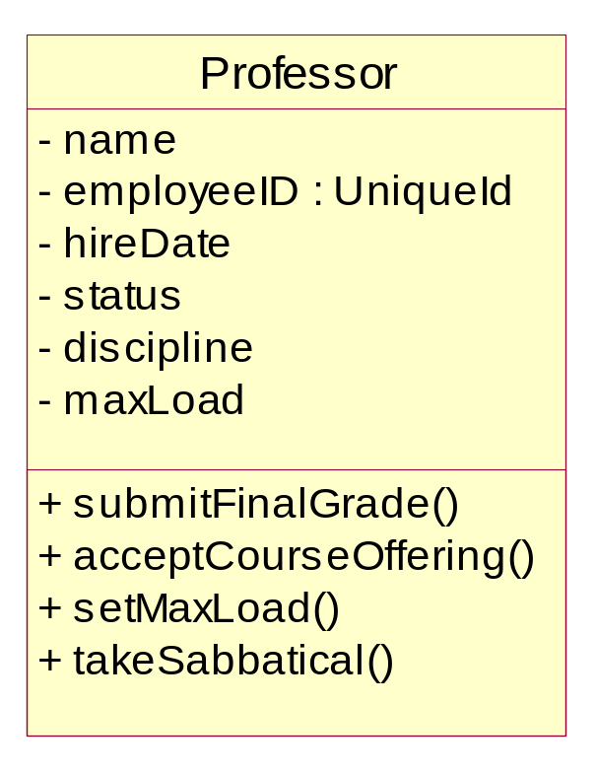
What Is a Class?
A class is a description of a set of objects that share the same properties and behavior.
  An object is an instance of a class.
Class: Professor
Objects
Attributes
Professor Smith
Professor Mellon
Professor Jones
Operations
Notes:
A Class can be defined as:
A description of a set of objects that share the same attributes, operations, relationships, and semantics. (The Unified Modeling Language User Guide, Booch, 1999)
There are many objects identified for any domain.
Recognizing the commonalties among the objects and defining classes helps us deal with the potential complexity.
The OO principle abstraction helps us deal with complexity.

Slide 30
A Sample Class
Class: Automobile
Data Items:
  manufacturer’s name
  model name
  year made
  color
  number of doors
  size of engine
  etc.
Methods:
  Define data items (specify manufacturer’s name, model, year, etc.)
  Change a data item (color, engine, etc.)
  Display data items
  Calculate cost
  etc.

Slide 31
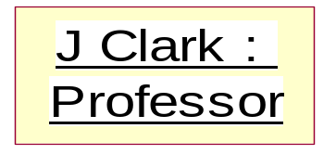
The Relationship Between Classes and Objects
A class is an abstract definition of an object.
  It defines the structure and behavior of each object in the class.
  It serves as a template for creating objects
Objects are grouped into classes.
An object is an instance of a class.
From Real World
Class: Professor
Professor Jones
Professor Smith
abstracting
Objects
Professor Mellon
instancing
Objects
To computer World
Notes:
A class is a description of a set of objects that share the same responsibilities, relationships, operations, attributes, and semantics.
An object is defined by a class. A class defines a template for the structure and behavior of all its objects. The objects created from a class are also called the instances of the class.
The class is the static description, and the object is a run-time instance of that class.
We model from real-world objects. Software objects are based on the real-world objects, but exist only in the context of the system.
We use real-world objects, abstract out what you don't care about. Then, take these abstractions and go through the process of classification based on what you do care about. Classes in the model are the result of this classification process.
These classes are then used as templates within an executing software system to create software objects. These software objects represent the real-world objects we originally started with.
Some classes/objects may be defined that don't represent real-world objects. They are there to support the design and are "software only.”
A class is to an object what a cookie cutter is to a cookie.

Slide 32
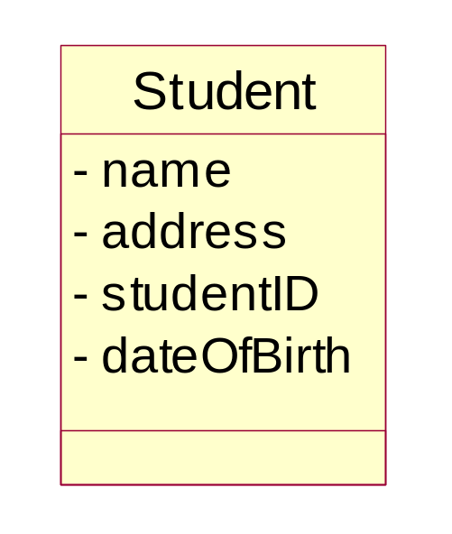
What Is an Attribute?
An attribute is a named property of a class that describes a range of values instances of the property may hold.
  A class may have any number of attributes or no attributes at all.
Attributes
Notes:
An attribute can be defined as:
A named property of a class that describes the range of values that instances of the property may hold. (The Unified Modeling Language User Guide, Booch, 1999)
A class may have any number of attributes or no attributes at all. At any time, an object of a class will have specific values for every one of its class’s attributes.
An attribute defined by a class represents a named property of the class or its objects. An attribute has a type that defines the type of its instances.
An attribute has a type, which tells us what kind of attribute it is. Typical attributes are integer, Boolean, real, and enumeration. These are called primitive types. Primitive types can be specific for a certain programming language.
Remember, there are still operations in this class, but we chose to suppress them.

Slide 33
Attributes in Classes and Objects
Class
name: M. Modano
address: 123 Main
studentID: 9
dateofBirth: 03/10/1967
Objects
name: D. Hatcher
address: 456 Oak
studentID: 2
dateofBirth: 12/11/1969
Notes:
At the class level, the Student class attributes indicate that the Students have names, addresses, studentID’s, and a date of birth.
At the object level, the attributes indicate the values for the name, address, studentID, and date of birth.
Only the class instance (objects) should be able to change the value of the attributes.
The state of an object is defined by the value of its attributes and the existence of links to other objects.
Remember, the doughnuts are not UML icons. They are included in this illustration to show that the attribute values are set in the individual object.
Object diagrams do not permit you to view the attribute values.

Slide 34
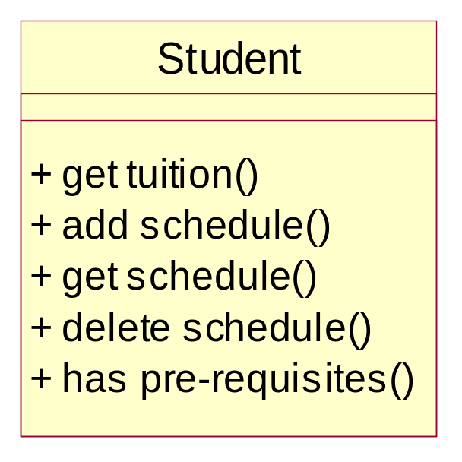
What Is an Operation?
An operation is the implementation of a service that can be requested from any object of the class to affect behavior.
A class may have any number of operations or none at all.
Operations
Notes:
An operation can be defined as:
The implementation of a service that can be requested from any object of the class to affect behavior. (The Unified Modeling Language User Guide, Booch, 1999)
The operations in a class describe what the class can do.
An operation can either be a command or a question. A question should never change the state of the object. Only a command can change the state of the object.
An operation is described with a return-type, name, and zero or more parameters. Together, the return-type, name, and parameters are called the signature of the operation.
The outcome of the operation depends on the current state of the object. Often, but not always, invoking an operation on an object changes the object’s data or state.
Point out that these should be called operations. Many people will use the term methods instead of operations.
In the UML, methods and operations are not synonymous and have distinct definitions.

Slide 35
Example: class Professor
class Professor {
private String name;
private int age;
private String speciality;
public Professor (String sm, int ia, String ss) {
name = sm;
age = ia;
speciality = sst;
}
public String getName () { return name;}
public int getAge () { return age;}
public String getSpeciality () {
return speciality;}
}
Professor
- name : String
- age : int
- speciality : String
+getName() : String
+getAge() : int
+getSpeciality() : String

Slide 36
Example : Instance of Professor
wang : Professor
name = “wang”
age = 35
speciality = “computer”
Professor wang = new Professor (“wang”, 35, “computer”);

Slide 37
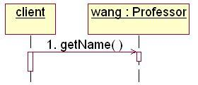

What is a message?
A specification of a communication between objects that conveys information with the expectation that activity will ensue
  One object asks another object to perform an operation.
What is your name?
Professor wang
wang.getName()

Slide 38
Example: Object Interaction
The OrderEntryForm wants Order to calculate the total dollar value for the order.
calculateOrderTotal()
CalculateOrderTotal()
orderID
date
salesTotal
tax
shipDate
Message
OrderEntryForm
Order
The class Order has the responsibility to calculate the total dollar value.
Notes:
This example demonstrates how objects interact to achieve the desired business functionality. The example is from an order-entry system where the order-entry clerk enters all sales information on the OrderEntryForm, stereotyped as a boundary class.
After all information has been entered into the form, the system must calculate the total dollar value for the sale. Calculating the total dollar value for the sale involves knowledge of the list price of the items in the sale, tax, and any discounts that may apply.
It does not make sense for the OrderEntryForm to calculate the total dollar amount because it does not own the attribute that stores this value. The object that owns this attribute is the Order object. Therefore, the Order object has an operation, calculateOrderTotal, that knows how to calculate the sales total. Also, in keeping with the principle of encapsulation, no other object should be allowed to change the value of sales total.
The OrderEntryForm knows that the sales total needs to be calculated. Therefore, it sends a message to Order to carry out this behavior. The Order object will calculate the total and send a return value back to the OrderEntryForm where the total can be displayed.
Point out how messages support the principle of encapsulation.
As a rule of thumb, if an attribute is owned by an object, that object needs to know how to calculate the values for that attribute. No other object should be able to do so.
Remember, class responsibilities are realized by its operations and attributes.

Slide 39
Foundations of Object Model
Structured design methods: algorithms are the building block
Object oriented design methods: object and classes are the building block
Object oriented decomposition can handle complexity better.
OOA, OOD, OOP

Slide 40
Foundations of Object Model
OOP: Object-oriented programming is a method of implementation in which programs are organized as cooperative collections of objects, each of which represents an instance of some class, and whose classes are all members of a hierarchy of classes united via inheritance relationships. [Grady Booch]
Object oriented programming:
  Uses objects (not algorithms) as fundamental logical building blocks (“part of” hierarchy)
  Each object is an instance of a class
  Classes are related to one another via inheritance(“is a” hierarchy)
OOP language provides mechanism that support the object-oriented style of programming well.
A language that does not provide direct support for inheritance is not object-oriented.

Slide 41
Foundations of Object Model
OOD: Object-oriented design is a method of design encompassing the process of object-oriented decomposition and a notation for depicting both logical and physical as well as static and dynamic models of the system under design. [Grady Booch]
Object oriented design:
  leads to an object oriented decomposition.
  uses different notations to express different models of the logical (class and object structure) and physical (module and process architecture) design of a system, in addition to its static and dynamic aspects.

Slide 42
Foundations of Object Model
OOA: Object-oriented analysis is a method of analysis that examines requirements from the perspective of the classes and objects found in the vocabulary of the problem domain. [Grady Booch]
Product of OOA is inputted to OOD.
Products of OOD can be used blueprints for implementing a system using OOP methods.

Slide 43
Foundations of Object Model
4 major elements of object model:
  Abstraction
  Encapsulation
  Modularity
  Hierarchy
3 minor elements of object model:
  Typing
  Concurrency
  Persistence

Slide 44
Basic Principles of Object Orientation
Object Orientation
Abstraction
Encapsulation
Inheritance
Polymorphism
Notes:
There are four basic principles of object orientation. They are:
Abstraction
Encapsulation
Inheritance
Polymorphism
Be sure the students understand objects before you begin this next section.
We’ve introduced objects first to help students better apply each of these principles.

Slide 45
What Is Abstraction?
Abstraction arises from a recognition of similarities between certain objects, situations, or processes in the real world, and the decision to concentrate upon these similarities and to ignore for the time being the differences. [Hoare]
A simplified description, or specification, of a system that emphasizes some of the system's details or properties while suppressing others. A good abstraction is one that emphasizes details that are significant to the reader or user and suppresses details that are, at least for the moment, immaterial or diversionary. [Shaw]
a concept qualifies as an abstraction only if it can be described, understood, and analyzed independently of the mechanism that will eventually be used to realize it. [Berzins, Gray, Naumann]
An abstraction denotes the essential characteristics of an object that distinguish it from all other kinds of objects and thus provide crisply defined conceptual boundaries, relative to the perspective of the viewer. [Grady Booch]

Slide 46

What Is Abstraction?
Abstraction can be defined as:
  Any model that includes the most important, essential, or distinguishing aspects of something while suppressing or ignoring less important, immaterial, or diversionary details. The result of removing distinctions so as to emphasize commonalties.
  (Dictionary of Object Technology, Firesmith, Eykholt, 1995)
Abstraction
  Emphasizes relevant characteristics.
  Suppresses other characteristics.
BriefCase
- Capacity
- Weight
+ open()
+ close()
Notes:
Abstraction can be defined as:
Any model that includes the most important, essential, or distinguishing aspects of something while suppressing or ignoring less important, immaterial, or diversionary details. The result of removing distinctions so as to emphasize commonalties. (Dictionary of Object Technology, Firesmith, Eykholt, 1995)
Abstraction allows us to manage complexity by concentrating on the essential characteristics of an entity that distinguish it from all other kind of entities.
An abstraction is domain and perspective dependent. That is, what is important in one context, may not be in another.
OO allows us to model our system using abstractions from the problem domain (for example, classes and objects).
A car is an example of an abstraction. A car is an abstraction for “a mobile, powered vehicle for transporting people from place to place.”
The abstract use of car is not concrete. However, if you describe the car as a 1995 Blue Ford Mustang, then it becomes a concrete manifestation and not an abstraction.
Discuss the makings of a good abstraction.
Concise
Single coherent concept, and so on

Slide 47


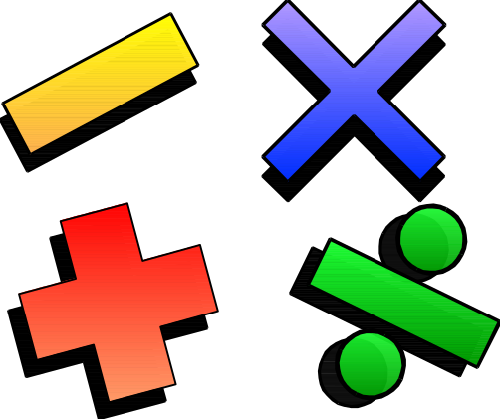

Example: Abstraction
Student
Professor
Course Offering (9:00 AM,
Monday-Wednesday-Friday)
Course (e.g. Algebra)
Notes:
The following are examples of abstraction.
A student is a person enrolled in classes in the university.
A professor is a person teaching classes at the university.
A course is a class offered by the university.
A course offering is a specific offering for a course, including days of the week and times.

Slide 48
What Is Encapsulation?
Encapsulation means to design, produce, and describe software so that it can be easily used without knowing the details of how it works.
Also known as information hiding
An analogy:
When you drive a car, you don’t have know the details of how many cylinders the engine has or how the gasoline and air are mixed and ignited.
Instead you only have to know how to use the controls.

Slide 49
What Is Encapsulation?
Hide implementation from clients
  clients depend on interface
Improves Resiliency
Notes:
Encapsulation can be defined as:
The physical localization of features (e.g., properties, behaviors) into a single blackbox abstraction that hides their implementation (and associated design decisions) behind a public interface. (Dictionary of Object Technology, Firesmith, Eykholt, 1995)
Encapsulation is often referred to as “information hiding,” making it possible for the clients to operate without knowing how the implementation implements the interface.
Encapsulation eliminates direct dependencies on the implementation (clients depend on/use the interface). Thus, it’s possible to change the implementation without updating the clients as long as the interface is unchanged.
Clients will not be affected by changes in implementation, thus reducing the “ripple effect,” where a correction to one operation forces the corresponding correction in a client operation and so on. As a result of encapsulation, maintenance is easier and less expensive.
Encapsulation offers two kinds of protection. It protects an object’s internal state from being corrupted by its clients and client code from changes in the object’s implementation.
Encapsulation is putting the “data bits” and operations that manipulate them in the same place.
Encapsulation does NOT allow direct manipulation of things that have been encapsulated without using the supplied interface.
An example is a car’s accelerator. Generally speaking, you put your foot down and the car goes faster. You don’t worry about the cables, electronics, engine, and the rest.

Slide 50
Encapsulation Illustrated
Professor Clark needs to be able to teach four classes in the next semester.
Professor Clark
SubmitFinalGrades()
AcceptCourseOffering()
Name: J Clark
Employee ID: 567138
HireDate: 07/25/1991
Status: Tenured
Discipline: Finance
MaxLoad:4
SetMaxLoad(4)
SetMaxLoad()
TakeSabbatical()
Notes:
The key to encapsulation is an object’s message interface. The object interface ensures that all communication with the object takes place through a set of predefined operations. Data inside the object is only accessible by the object’s operations. No other object can reach inside of the object and change its attribute values.
For example, Professor Clark needs to have her maximum course load increased from three classes to four classes per semester. Another object will make a request to Professor Clark to set the maximum course load to four. The attribute, MaxLoad, is then changed by the SetMaxLoad() operation.
Encapsulation is beneficial in this example because the requesting object does not need to know how to change the maximum course load. In the future, the number or variables that are used to define the maximum course load may be increased, but doesn’t not affect the requesting object. It depends on the operation interface for the Professor Clark object.
Note that encapsulation can also be illustrated using interfaces. However, the scope of this course does not include this discussion.
Point out that the requesting object does not need to know the structure of the Professor object to request a state change.
The object that owns the attributes is the only one allowed to change its own attributes.

Slide 51
Encapsulation – Information/Implementation hiding
Information which can’t be accessed by client
Balance
insterestYTD
Owner
Account_number
Deposit() {…}
Withdraw() {…}
Transfer() {…}
Interface
Client
Deposit()
Withdraw()
Transfer()
Implementation details which are invisible to the client.

Slide 52
What Is Inheritance ?
Inheritance —a way of organizing classes
Term comes from inheritance of traits like eye color, hair color, and so on.
Classes with properties in common can be grouped so that their common properties are only defined once.
Is an “is a kind of” relationship

Slide 53
An Inheritance Hierarchy
Vehicle
Automobile
Motorcycle
Bus
Sedan
Sports Car
School Bus
Luxury Bus
What properties does each vehicle inherit from the types of vehicles above it in the diagram?

Slide 54
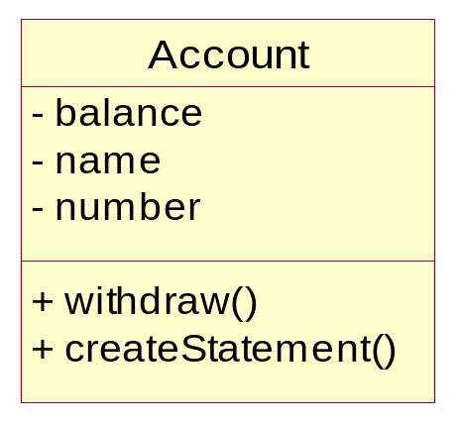
Example: Single Inheritance
One class inherits from another.
Ancestor
Superclass (parent)
Inheritance Relationship
Savings
Checking
Subclasses
Descendents
Notes:
The generalization is drawn from the subclass class to the superclass/parent class.
The terms “ancestor” and “descendent” may be used instead of “superclass” and “subclass.”

Slide 55
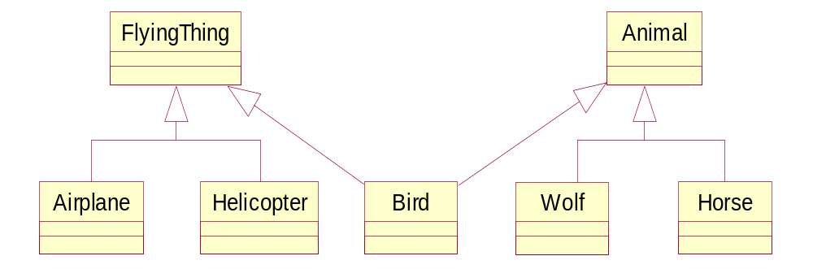
Example: Multiple Inheritance
A class can inherit from several other classes.
Multiple Inheritance
Use multiple inheritance only when needed and
always with caution!
Notes:
Multiple inheritance means that a class can inherit from several other classes. For example, Bird inherits from both FlyingThing and Animal.
Multiple inheritance is conceptually straight forward and may be needed to model the real world accurately. However, there are potential implementation problems when you use multiple inheritance, and not all implementation languages support it. Thus, be judicious with your use of multiple inheritance. Use it only where it accurately describes the concept you are trying to model and reduces the complexity of your model. Be aware, however, that this representation will probably need to be adjusted in design and implementation.
Generally, a class inherits from only one class.
Some languages do not support multiple inheritance.

Slide 56
Polymorphism
Polymorphism—the same word or phrase can be mean different things in different contexts
Analogy: in English, bank can mean side of a river or a place to put money
In Java, two or more classes could each have a method called output
Each output method would do the right thing for the class that it was in.
One output might display a number whereas a different one might display a name.

Slide 57
What Is Polymorphism?
The ability to hide many different implementation behind a single interface.
Manufacturer B
Manufacturer A
Manufacturer C
OO Principle:
Encapsulation
Notes:
The Greek term polymorphos means “having many forms.” Every implementation of the interface must implement at the very least the interface. In some cases, the implementation can implement more than the interface.
For example, the same remote can be used to control any type of television that supports a specific interface (the interface the remote was designed to be used with).

Slide 58
Example: Polymorphism
Get Current Value
getCurrentValue()
getCurrentValue()
getCurrentValue()
Stock
Bond
Mutual Fund
Notes:
In this example, a requesting object would like to know the current value of a financial instrument. However, the current value for each financial instrument is calculated in a different fashion. The stock needs to determine the current asking price in the financial market that it is listed under. The bond needs to determine the time to maturity and interest rates. A mutual fund needs to look up the closing price from the day from the fund management company.
In a non object-oriented development environment, we would write code that may look something like this:
IF financialInstrument = Stock THEN
calcStockValue()
IF financialInstrument = Bond THEN
calcBondValue()
IF financialInstrument = MutualFund THEN
calcMutualFundValue()
With object technology, each financial instrument can be represented by a class, and each class would know how to calculate its own value. The requesting object simply needs to ask the specific object (for example, Stock) to get its current value. The requesting object does not need to keep track of three different operation signatures. It only needs to know one. Polymorphism allows the same message to be handled in different ways depending on the object that receives it.
This diagram shows how three different object can have the same operation: getCurrentValue().
However, the way that each interprets that operation is unique because the current value for each instrument is dependent on different variables.
Point out that the requesting object does not need to know anything about the calculations or the differences. All it cares is that the current value is calculated.

Slide 59

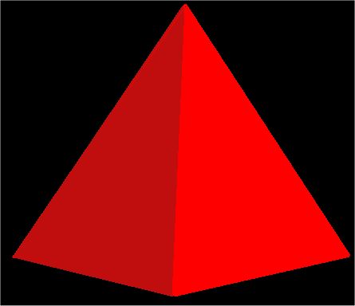
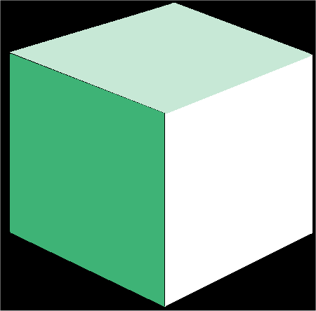
What is an Interface?
An interface is a collection of operations that specify a service of a class or component.
Interfaces formalize polymorphism
Interfaces support “plug-and-play” architectures
‘How’
Tube
<<Interface>>
Shape
‘What’
Pyramid
draw()
move()
scale()
rotate()
Cube
Realization relationship
(stay tuned for realization relationships)
Notes:
Interfaces are not abstract classes, as abstract classes allow you to provide default behavior for some/all of their methods. Interfaces provide no default behavior.
From the UML User’s Guide (Booch, 1999): An interface is “a collection of operations that are used to specify a service of a class or a component.”
Interfaces formalize polymorphism. They allow us to define polymorphism in a declarative way, unrelated to implementation. Two elements are polymorphic with respect to a set of behaviors if they realize the same interfaces. In other words, if two objects use the same behaviors to get different, but similar results, they are considered to be polymorphic. A cube and a pyramid can both be drawn, moved, scaled, and rotated, but they look very different.
You’ve probably heard that polymorphism one of the big benefits of object orientation, but without interfaces there was no way to enforce it, verify it, or even express it except in informal or language-specific ways. Formalization of interfaces strips away the mystery of polymorphism and gives us a good way to describe, in precise terms, what polymorphism is all about. Interfaces are testable, verifiable, and precise.
Interfaces are the key to the “plug-and-play” ability of an architecture: Any classifiers (e.g., classes, subsystems, components) which realize the same interfaces may be substituted for one another in the system, thereby supporting the changing of implementations without affecting clients.
Realization relationships are discussed later in this module.

Slide 60
How Do You Represent An Interface?
Elided/Iconic Representation
(“lollipop”)
Tube
Pyramid
Shape
Cube
Canonical (Class/Stereotype) Representation
Tube
<<Interface>>
Shape
Pyramid
draw()
move()
scale()
rotate()
Cube
(stay tuned for realization relationships)
Notes:
The lollipop notation is best used when you only need to denote the existence of an interface. If you need to see the details of the interface (e.g., the operations), then the class/stereotype representation is more appropriate.
From The Random House Collegiate Dictionary:
Elide: “to pass over; omit; ignore.”
Canonical: “authorized; recognized; accepted.”
According to the “UML User Guide” there are two ways to represent a realizes relationship with an interface. The Elided form (“Lollipop”) is useful when you want to expose the seams of the system, however, there is a limitation in that you can’t visualize the operations on the interface.
The second way, canonical, allows you to visualize the operations on the interface.

Slide 61
What is an Abstract Class?
An abstract class is a class that may not have any direct instances.
In the UML, you specify that a class is abstract by writing its name in italics.
An abstract operation is an operation that it is incomplete and requires a child to supply an implementation of the operation.
In the UML, you specify an abstract operation by writing its name in italics.
Shape
{abstract}
Abstract class
draw () {abstract}
Abstract operation
Circle
Rectangle
draw ()
draw ()
Notes:
In the Best Practices module, we discussed some characteristics common to successful projects. OO facilitates the following best practices:
Develop Iteratively
Model Visually
Use Component Architecture
Defining basic OO terms and concepts allows everyone in the class to start on a level playing field.

